Slide 1
Software Product Management
Introduction
Joydeep Barman

Slide 2
Contents
About this course
Software products scenario
What is spurring product industry?
Different product categories
Project business vs Product business
What is Product management?

Slide 3
Software products scenario

Slide 4
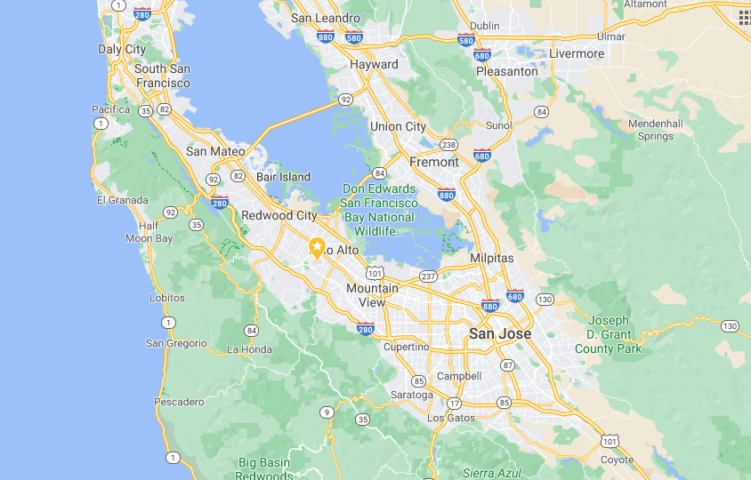
Software product revolution started in Silicon valley
Stanford University
Silicon valley
Early companies in Silicon valley: HP, Xerox, Apple, Oracle,…..

Slide 5
How Silicon Valley became successful?
Convergence of Academia (Stanford, UC Berkley), the Private Sector, and Government
High Density of Wealthy Investors and Funding Institutions
Inspiration From Past Success Stories
Cultural diversity: Half the startups belong to Indians and Chinese
Level-headed Approach to Failure

Slide 6
Today there are 1K+ unicorns across the world
Country | # of Unicorns
United States | 300+
China | 140+
India | 50+
United Kingdom | 30+
Germany | 12
South Korea | 11
https://www.cbinsights.com/research-unicorn-companies

Slide 7
Unicorns by industry
Industry | # of Unicorns
Fintech | 80+
Internet software & services | 70+
E-commerce & direct-to-consumer | 70+
Artificial intelligence | 50+
Mobile & telecommunications | 35+
Health | 35+
https://www.cbinsights.com/research-unicorn-companies

Slide 8
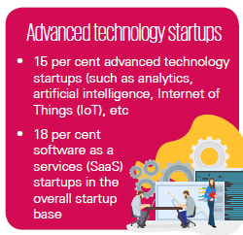
Tech start-ups – Advanced technology (India)
KPMG report: https://home.kpmg/in/en/home/insights/2019/01/startup-landscape-ecosystem-growing-mature.html

Slide 9
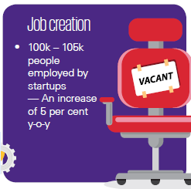
Tech start-ups – job creation (India)
KPMG report: https://home.kpmg/in/en/home/insights/2019/01/startup-landscape-ecosystem-growing-mature.html

Slide 10
What is spurring product industry?
Global market reach
Cloud resources – Amazon AWS, Microsoft Azure, IBM, Google
Funding – 100+ angel investors in 2022
Talent pool

Slide 11
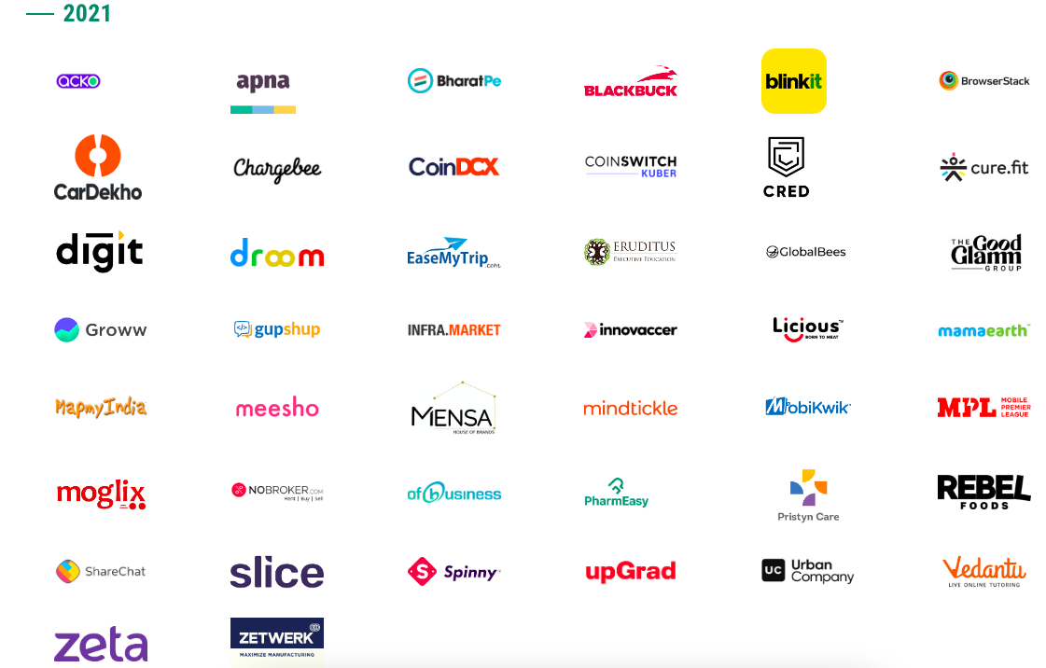
Unicorns in India
Courtesy: https://www.ventureintelligence.com/Indian-Unicorn-Tracker

Slide 12

Unicorns in India
Courtesy: https://www.ventureintelligence.com/Indian-Unicorn-Tracker

Slide 13
Product categories

Slide 14
Product categories
By industry – Finance, Health, Retail, Travel
By technology – AI/ML, Analytics, Robotics, IoT
B2B vs B2C
SaaS vs On-premise
Mobile vs Web
Regular vs API products (Payment gateway, Google Maps, SMS gateway, Banking API)
Product vs Product-cum-service (Ola, Uber, Flipkart)
Product (Paytm), Product platform (Ola), Product family (Office on Windows, Office on Mac, Office on Android), Product Line (Roclwell Collin avionics)
Any other?

Slide 15
Industry segments
E-Commerce
HealthTech
FinTech
EdTech
TravelTech
Logistics
Consumer services
Enterprise Tech
Deep tech
Software dev
– Amazon, Flipkart
– Practo, Tata Health, Qure.ai
– Paytm, Razorpay
- Byju’s, upGrad, Udemy
– MakeMyTrip, Tripadvisor
– Xpressbees, Dunzo, Delhivery
– Swiggy, Zomato
– Zoho, Kissflow, DarwinBox
- Niflr, Logically, AskSarkar
– Postman, WorkDuck

Slide 16
Product platform
Product platform: Amazon AWS, Android, Uber, PayPal, Facebook
  The technical foundation / eco system on which several software products are based.

Slide 17
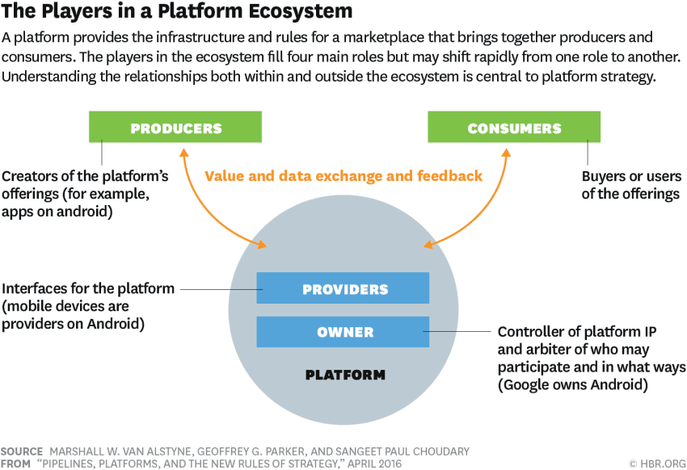
Product platform
Image Source: https://hbr.org/2016/04/pipelines-platforms-and-the-new-rules-of-strategy

Slide 18
Product family
Product family: Microsoft Office (Word, Excel, PowerPoint, OneNote, Outlook)
  A group of software products that are marketed as belonging together under a common family name

Slide 19

Product line
Product line: Rockwell Collins Avionics systems for different helicopters
  a collection of similar software systems from a shared set of software assets using a common means of production.

Slide 20
Product business and Project business
Dimension | Product | Project
Risk | High | Low
Returns | High | Low
Duration | Ongoing | Pre-determined
Customers | Many | One
Objective | Discovered | Given
Funding | Internal & external | Internal
Marketing effort | High | Low
Management | Strategic | Tactical / operational

Slide 21
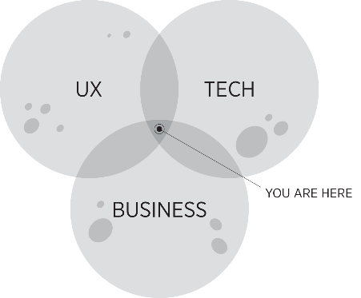
What is Product Management?
“The job of a product manager is to discover a product that is valuable, usable and feasible.” – Marty Cagan, Author of ‘Inspired’
“Product management is an intersection between business, user experience, and technology” – Martin Eriksson, Author of Product Leadership
“Product management is the glue that holds together all the various functions” - Ken Norton, Product Partner at Google Ventures

Slide 22
Product Management role
You need to be really good at strategy, be inspirational, and understand the long-term picture.
At the same time, you have to be really good at the operational side and making things happen
    Setting a vision
    Creating a roadmap
    Build the product
    Talk to customers
You need the soft skills of persuasion, negotiation, storytelling, vision setting and communication

Slide 23
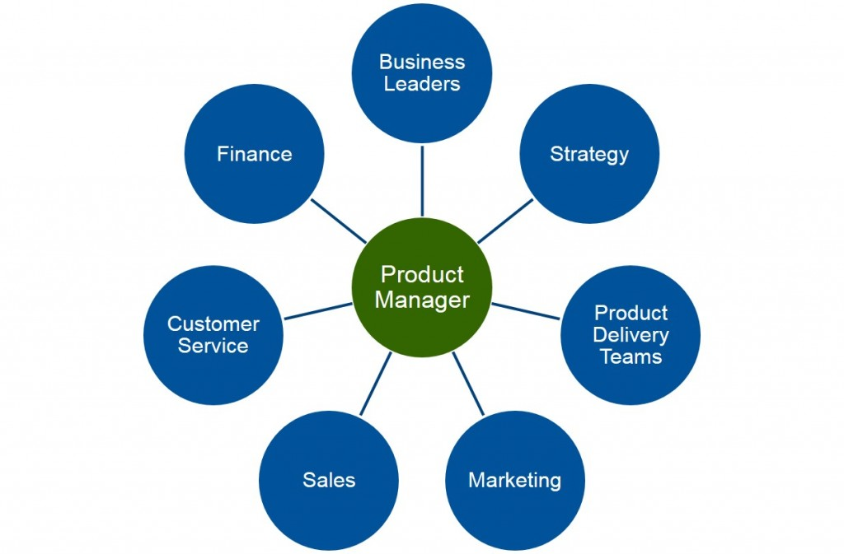
Product Management role
Ref: Product Plan.com

Slide 24
About the course
Hope you have the handout!

Slide 25
Sharing thoughts
Name one product company you admire.
What is the reason you admire this company?

